Slide 1
Technology Discover Graduate Programme
Vodafone
Kirill Nevzorov

Slide 2
Who am I
Passionate Unix-based developer
Code quality advocate
Flexible learner
10 years of Java experience
Gap year in IT/Programming for a London based Law firm (CMS CMNO)
Experience in Bash/C/C++/Python/Web and other languages
Wide range of technologies, from desktop and systems programming to Unix and Windows administration (devops)
Experience
Notes:
Introduction
What makes me good for this position?
I’ve self taught myself majority of the technologies that I employ in my work.
Started learning Java at 10
Using linux for 6 years
Experience picking up many different technologies as needed
Made websites, binary applications, managed servers for CMS

Slide 3
Creating good code,
a 5 minute lesson:
How aesthetics
produce programs
which are easy
to code
Notes:
What I wanted to talk about today is “Good Code”.
I have experience programming under different circ

Slide 4
Coding?
Understanding
Writing
Reading

Slide 5
What is Simple Code
Readable
Maintainable
Replaceable

Slide 6
How to write Simple Code
State intent with variable/function names
Reason about code in pseudo English
Avoid “mathspeak”
Compose behaviours using functions
Functions are a way to name blocks of code
Let the compiler check your logic
Keep everything local on the screen
Avoid mental gymnastics
Don’t abuse short-term memory

Slide 7
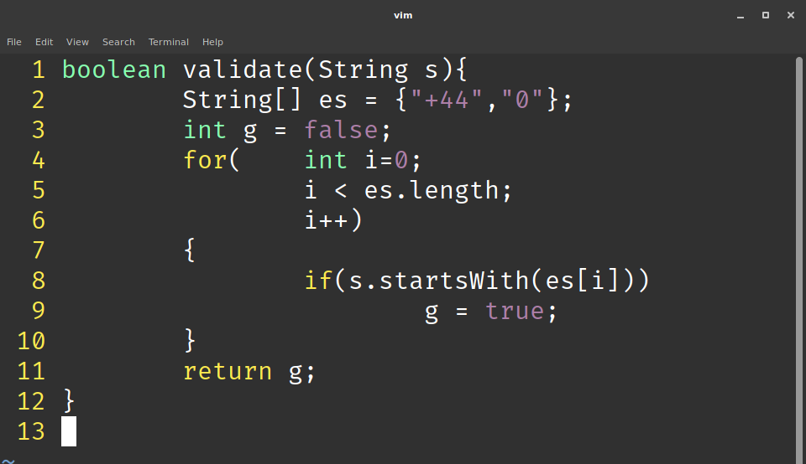
Bad Code?

Slide 8
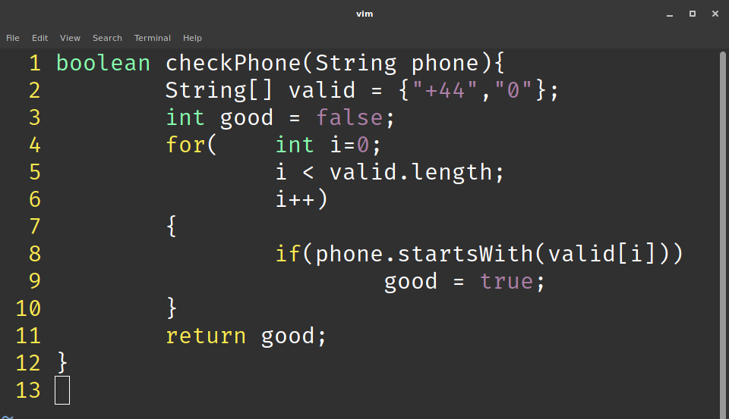
Better Code?

Slide 9
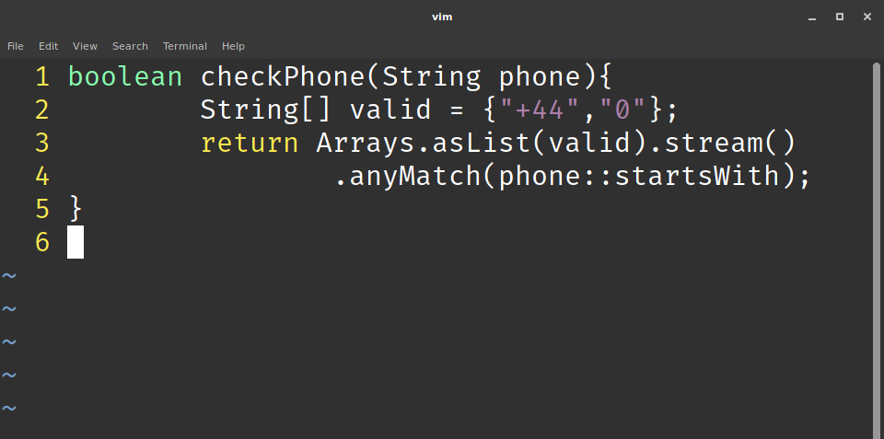
Better Code

Slide 10
Effects of Simple Code
Easier to present
Code fits on one screen
No need to memorise variables
Easier to write
State intent first, implement later
Break down a problem stepwise
Easier to maintain
Self-documenting
Navigable without external tools (IDE)

Slide 11
References
Gregory, K. (2018). CppCon 2018: Kate Gregory “Simplicity: Not Just For Beginners”. [online] YouTube. Available at: https://www.youtube.com/watch?v=n0Ak6xtVXno [Accessed 10 Mar. 2019].
Wild, R. (2018). Higher-Order Functions I: Function Composition and the Monad Pattern - DZone Java. [online] dzone.com. Available at: https://dzone.com/articles/higher-order-functions-i-function-composition-and [Accessed 13 Mar. 2019].

Slide 12
Thank you

